Slide 1
Greedy algorithms 2 Caching, Compression
CS240 Spring 2024
Rui Fan

Slide 2
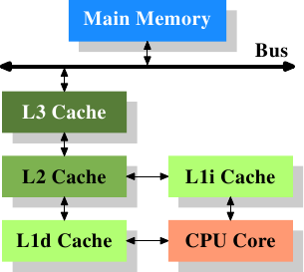
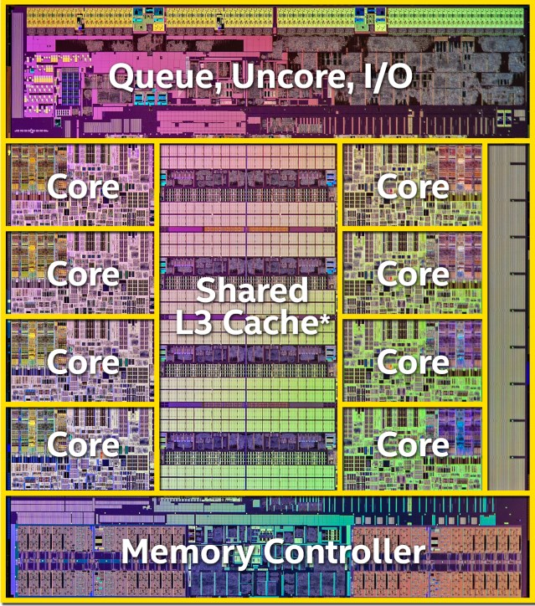
Caching
Cache is a piece of on-chip (fast) memory.
Reduces effective access time to slow main memory.
When accessing memory, first try to find it in cache.
Only if it’s not in cache do we access main memory.
Typically cache has ~1-20 cycles latency, memory has ~200-500 cycles latency.
Since caches are on-chip, amount is usually quite small (~32 KB to ~4 MB).
Only store the most important, frequently accessed data in cache.
Use caching algorithm to select which data to store.

Slide 3
Optimal Offline Caching
Caching.
Cache with capacity to store k items.
Sequence of m item requests d₁, d₂, …, d_{m}.
Cache hit: item already in cache when requested.
Cache miss: item not already in cache when requested: must load requested item from main memory into cache, and evict some existing item, if full.
Goal. Eviction schedule that minimizes number of evictions.
Ex: k = 2, initial cache = ab, requests: a, b, c, b, c, a, a, b.
Optimal eviction schedule: 2 evictions.
a
a
b
b
a
b
c
c
b
b
c
b
c
c
b
a
a
b
a
a
b
b
a
b
requests
cache

Slide 4
Optimal Offline Caching: Farthest-In-Future
Farthest-in-future. Evict item in the cache that is not requested until farthest in the future.
Theorem. [Bellady, 1960s] FF is optimal eviction schedule.
Pf. Algorithm and theorem are intuitive; proof is subtle.
current cache:
a
b
c
d
e
f
future queries:
g a b c e d a b b a c d e a f a d e f g h ...
cache miss
eject this one

Slide 5
Reduced Eviction Schedules
Def. A reduced schedule is a schedule that only inserts an item into the cache in a step in which that item is requested.
Intuition. Can transform an unreduced schedule into a reduced one with no more evictions.
a
a
b
c
a
a
b
c
a
a
x
c
a
a
b
c
c
a
d
c
c
a
b
c
d
a
d
b
d
a
d
c
a
a
x
b
a
a
d
c
b
a
c
b
b
a
d
b
c
a
c
b
c
a
c
b
a
a
b
c
a
a
c
b
a
a
b
c
a
a
c
b
an unreduced schedule
a reduced schedule

Slide 6
Reduced Eviction Schedules
Claim. Given any unreduced schedule S, can transform it into a reduced schedule S' with no more evictions.
Pf. (by induction on number of unreduced items)
Suppose S brings d into the cache at time t, without a request.
Let c be the item S evicts when it brings d into the cache.
Case 1: d evicted at time t', before next request for d.
S’ has one less eviction than S by time t’.
Case 2: d requested at time t' before d is evicted.
S’ and S have same number of evictions by time t’.
doesn't enter cache at requested time
S
S'
S
S'
c
c
c
c
t
t
t
t
d
d
t'
t'
t'
t'
e
d evicted at time t', before next request
e
d requested at time t'
d
Case 1
Case 2
Notes:
Note: can't assume a priori that events in unreduced schedule occur solely at request times

Slide 7
Farthest-In-Future: Analysis
Lemma. Let S be a reduced schedule that makes the same schedule as S_{FF} through the first j requests. Then there is a reduced schedule S’ that makes the same schedule as S_{FF} through the first j+1 requests, and incurs no more evictions than S does.
Pf.
Consider (j+1)^{st} request d = d_{j+1}.
Since S and S_{FF} have agreed up until now, they have the same cache contents before request j+1.
Case 1: (d is already in the cache). S' = S
Case 2: (d is not in the cache and S and S_{FF} evict the same element). S' = S

Slide 8
Farthest-In-Future: Analysis
Pf. (continued)
Case 3: (d is not in the cache; S_{FF} evicts e; S evicts f ≠ e).
begin construction of S' from S by evicting e instead of f
now S' agrees with S_{FF} on first j+1 requests
From request j+2 onward, we make S’ the same as S, but this becomes impossible when e or f is involved
j
same
e
f
same
e
f
S
S'
j+1
same
e
d
same
d
f
j
S
S'

Slide 9
Farthest-In-Future: Analysis
Pf. (continued)
Let j' be the first time after j+1 that S and S' take a different action, and let g be item requested at time j'.
Case 3a: g = e.
f couldn’t have been requested between time j+1 and j’, because if it had been, S and S’ would have taken different actions before j’.
So e is requested before f. But this can't happen with Farthest-In-Future, since S_{FF} evicted e, implying f is requested before e.
must involve e or f (or both)
j'
same
e
same
f
S
S'

Slide 10
Farthest-In-Future: Analysis
Pf. (continued)
Let j' be the first time after j+1 that S and S' take a different action, and let g be item requested at time j'.
Case 3b: g ≠ e, f. S must evict e. Make S' evict f; now S and S' have the same cache. ▪
j'
same
e
same
f
S
S'
S can’t evict f, and if it evicts e’ ≠ e, f, then S’, by construction, would do the same thing.
j'
same
g
same
g
S
S'

Slide 11
Farthest-In-Future: Analysis
Pf. (continued)
Let j' be the first time after j+1 that S and S' take a different action, and let g be item requested at time j'.
Case 3c: g = f. Element f can't be in cache of S, so let e' be the element that S evicts.
if e' = e, S' accesses f from cache; now S and S' have same cache
if e' ≠ e, S' evicts e' and brings e into the cache; now S and S' have the same cache.
S' is no longer reduced, but can be transformed using procedure on slide 6 into a reduced schedule which
agrees with S_{FF} through step j+1
has no more evictions than S
j'
same
e
same
f
S
S'
Notes:
Note: the transformation does not change any action before j’

Slide 12
Farthest-In-Future: Analysis
Theorem. FF is optimal eviction algorithm.
Pf. (by induction on number of requests j)
Base case (trivial): There exists an optimal reduced schedule S that makes the same schedule as S_{FF} through the first 0 requests.
Inductive step (implied by the lemma):
If there exists an optimal reduced schedule S that agrees with S_{FF} through the first j requests,
then there exists an optimal reduced schedule S’ that agrees with S_{FF} through the first j+1 requests

Slide 13
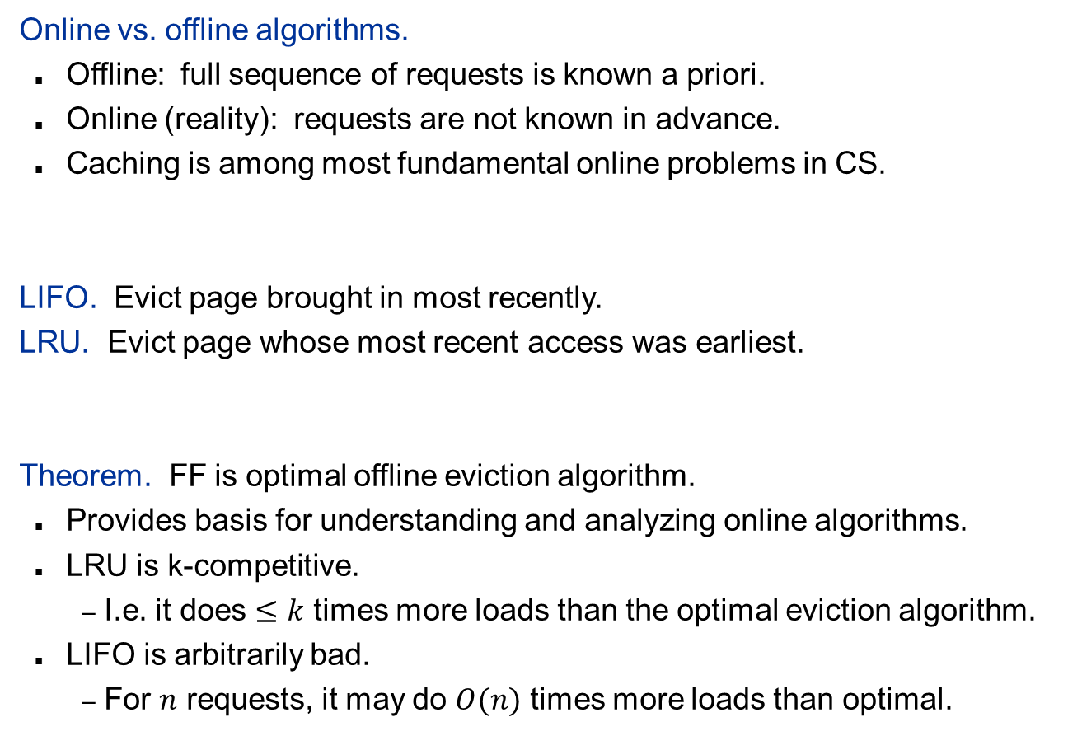
Caching Perspective
Online vs. offline algorithms.
Offline: full sequence of requests is known a priori.
Online (reality): requests are not known in advance.
Caching is among most fundamental online problems in CS.
LIFO. Evict page brought in most recently.
LRU. Evict page whose most recent access was earliest.
Theorem. FF is optimal offline eviction algorithm.
Provides basis for understanding and analyzing online algorithms.
LRU is k-competitive.
I.e. it does $≤k$ times more loads than the optimal eviction algorithm.
LIFO is arbitrarily bad.
For $n$ requests, it may do $O(n)$ times more loads than optimal.
FF with direction of time reversed!

Slide 14

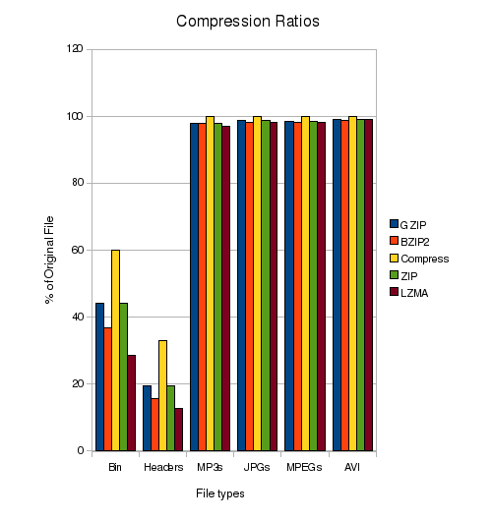
Compression
Storing and transmitting data is expensive. Compression represents data more compactly.
ASCII has 256 characters, so we use log₂(256)=8 bits to represent each character.
But typically some characters appear more often than others. So we shouldn’t use same number of bits for all letters.
Basic idea for compression is to use different length bitstrings.
Use short bitstrings to represent common characters.
Use long bitstrings to represent uncommon characters.
We save space on average.

Slide 15
Lossless vs. lossy compression
Different algorithms for different applications.
Lossless compression used in settings where losing even one bit can make data useless.
Ex Computer code, financial document.
Typical compression ratio is 2:1.
Huffman encoding is loseless.
Lossy compression used when data still useful after losing some information.
Ex Audio and video, MP3 and MPEG.
We can’t hear high frequencies or see fast movement, so we can discard this info.
Typical compression ratio is 5:1-50:1.

Slide 16
Variable length encoding
Let’s compress “lollapalooza”.
There are 5 different letters. If we use the same length bitstring to represent each letter, we need 3 bits per letter.
We use 36 bits total.
To use different length bitstrings, first count how many times each letter appears.
4 l’s, 3 a’s, 3 o’s, 1 p, 1z.
Use shorter bitstrings for more frequent letters.
Use the encoding l=00, a=01, o=10, p=110, z=111.
Encoding of “lollapalooza” is 00100000011100100101011101, formed by replacing each letter by its encoding.
We use 26 bits, for a 28% savings.

Slide 17
Ambiguity
We want the codewords to be short, but we also need them to be unambiguously decodable.
Ex If we use l=0, a=01, o=10, p=110, z=111, then “lollapalooza” is only 22 bits.
But we can’t decode this encoding!
If we see 00010, we can’t tell whether this is encoding llal=[0,0,01,0], or lllo=[0,0,0,10].
We could use a separator, 0#0#01#0 vs 0#0#0#10. But that’s wasteful.
Instead, we use prefix-free codes, which are unambiguously decodable.

Slide 18
Prefix-free codes
Let W be the set of codewords we use. Then W is prefix-free if no codeword in W is a prefix of another codeword.
00,10,001,100 is not prefix-free.
00 is a prefix of 001, and 10 is a prefix of 100.
00,01,10,110,111 is prefix-free.
Prefix-free codes allow unique decoding.
Given the encoded string, just keep reading until you’ve read a complete codeword.
This codeword can’t be part of a longer codeword, because the code is prefix-free.

Slide 19
Decoding prefix-free codes
Let S=00100000011100100101011101, W={00,01,10,110,111 }, representing l,a,o,p,z.
00100000011100100101011101 00→l
00100000011100100101011101 10→o
00100000011100100101011101 00→l
00100000011100100101011101 00→l
00100000011100100101011101 00→a
00100000011100100101011101 110→p
…

Slide 20
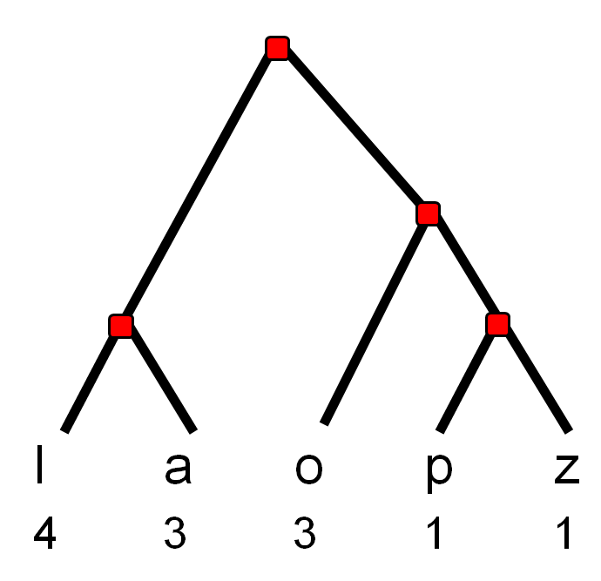
Huffman coding
Huffman encoding is an optimal prefix-free code, invented in 1951.
First, find the frequencies of the letters in your text.
For “lollapalooza”, it’s [l,a,o,p,z] →[4,3,3,1,1].
Now, build a binary tree on the letters bottom up.
Make each letter a leaf, and set its weight to its frequency.
Take the two lowest weight nodes
Make them the children of a parent node.
Set the weight of the parent node equal to the sum of the weights of the two children.
Remove the two nodes.
Notice this is a greedy step.
Repeat till all nodes part of one tree.
Represent left by 0, right by 1.
A letter’s encoding is represented by its path from the root.

Slide 21
Huffman coding example
l
a
o
p
z
4
3
3
1
1

Slide 22
Huffman coding example
2
l
a
o
p
z
4
3
3
1
1

Slide 23
Huffman coding example
5
2
l
a
o
p
z
4
3
3
1
1

Slide 24
Huffman coding example
5
7
2
l
a
o
p
z
4
3
3
1
1

Slide 25
Huffman coding example
12
5
7
2
l
a
o
p
z
4
3
3
1
1

Slide 26
Huffman coding example
Convert the Huffman tree into a binary encoding, by treating left (right) branches as 0’s (1’s).
The encoding of the letters corresponds to their path from the root.
0
1
0
1
0
1
0
1
l
a
o
p
z
00
01
10
110
111

Slide 27
Huffman implementation
Let S=s₁s₂…s_{n} be a string. Let f(s) be the number of occurrences of char s in S.
for i=1 to n
add (s_{i}, f(s_{i})) to a min-heap H
for i=1 to n-1
left ← removeMin(H)
right ← removeMin(H)
make a new node parent
set parent’s left and right children to left, right
add(parent, f(left) + f(right)) to H
a letter’s encoding is represented by its path

Slide 28
Huffman’s complexity
Total time is O(n²).
Each add takes O(log n) time.
for i=1 to n
add (s_{i}, f(s_{i})) to a min-heap H
for i=1 to n-1
left ← removeMin(H)
right ← removeMin(H)
make a new node parent
set parent’s left and right children to left, right
add(parent, f(left) + f(right)) to H
a letter’s encoding is represented by its path.
Each remove takes O(log n) time.
There are n letter, each has O(n) height, so the total time is O(n²).
Add takes O(log n) time.

Slide 29
Huffman code is prefix-free
Any two codewords correspond to paths from the root to leaves.
The 2 paths split from each other somewhere.
After the split, neither codeword is a prefix of the other.
Huffman codes are uniquely decodable.
0
1
0
1
0
1
0
1
l
a
o
p
z
00
01
10
110
111

Slide 30
Huffman code is optimal
Huffman encoding gives the shortest uniform encoding of strings.
Uniform basically means you can’t change your encoding method for different strings.
Call an encoding in which codewords are derived from paths in trees a tree code.
Fact There exists tree codes that are optimal.
Since the Huffman code is a tree code, to prove Huffman is optimal, we just need to prove it’s an optimal tree code.
l
a
o
p
z
4
3
3
1
1
00
01
10
110
111

Slide 31
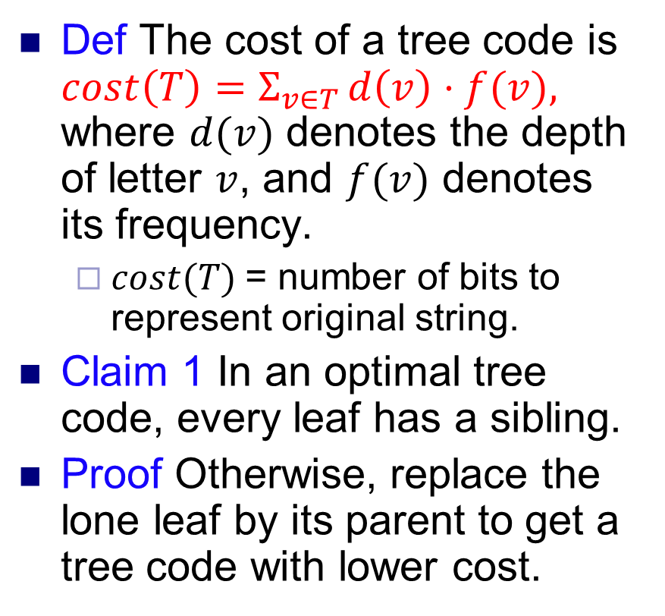
Huffman code is optimal
Def The cost of a tree code is $cost\left(T\right)=Σ_{v∈T} d\left(v\right)⋅f(v),$ where $d(v)$ denotes the depth of letter $v$, and $f(v)$ denotes its frequency.
$cost(T)$= number of bits to represent original string.
Claim 1 In an optimal tree code, every leaf has a sibling.
Proof Otherwise, replace the lone leaf by its parent to get a tree code with lower cost.
l
a
o
p
z
4
3
3
1
1
00
01
10
110
111
cost(T) = 4*2+3*2+3*2+ 3*1+3*1=26

Slide 32
Huffman code is optimal
Claim 2 Consider the two least frequent letters x and y. In the an optimal tree code T, x and y are siblings of each other at the max depth of the tree.
Proof Suppose not, and let p be a node at the max depth.
p has a sibling q by Claim 1.
p and q have higher frequency than x and y, resp.
Create a new tree where we swap p and x, and q and y.
The new tree has strictly lower cost than T, since p, q have higher frequency than x, y. Contradiction.
y
x
p
q
q
p
x
y

Slide 33
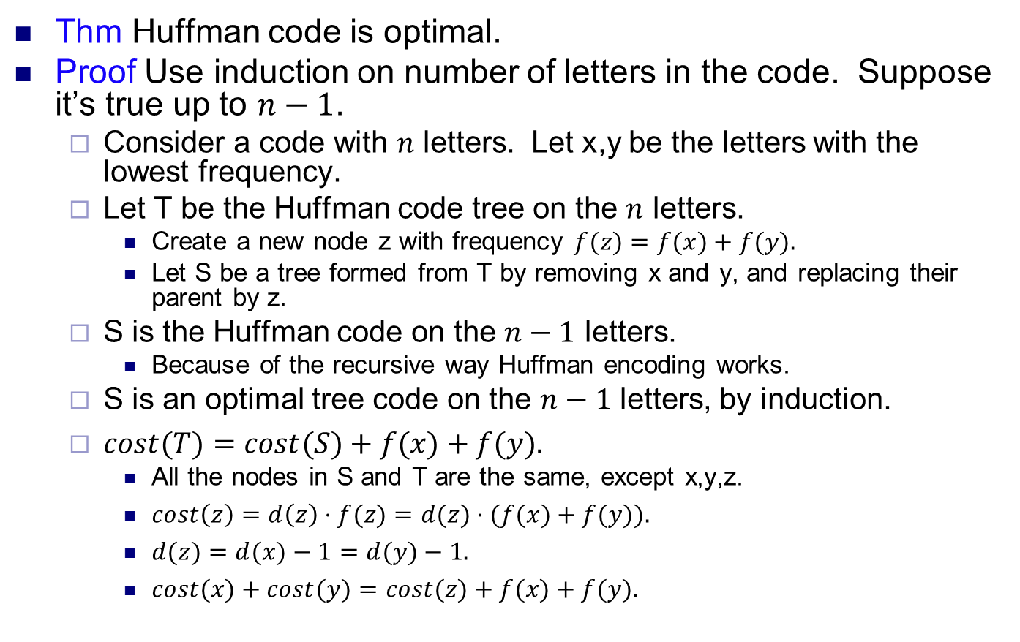
Huffman code is optimal
Thm Huffman code is optimal.
Proof Use induction on number of letters in the code. Suppose it’s true up to $n−1$.
Consider a code with $n$ letters. Let x,y be the letters with the lowest frequency.
Let T be the Huffman code tree on the $n$ letters.
Create a new node z with frequency $f(z)=f(x)+f(y).$
Let S be a tree formed from T by removing x and y, and replacing their parent by z.
S is the Huffman code on the $n−1$ letters.
Because of the recursive way Huffman encoding works.
S is an optimal tree code on the $n−1$ letters, by induction.
$cost(T)=cost(S)+f(x)+f(y).$
All the nodes in S and T are the same, except x,y,z.
$cost\left(z\right)=d\left(z\right)⋅f(z)=d(z)⋅(f(x)+f(y)).$
$d(z)=d(x)−1=d(y)−1.$
$cost(x)+cost(y)=cost(z)+f(x)+f(y).$

Slide 34
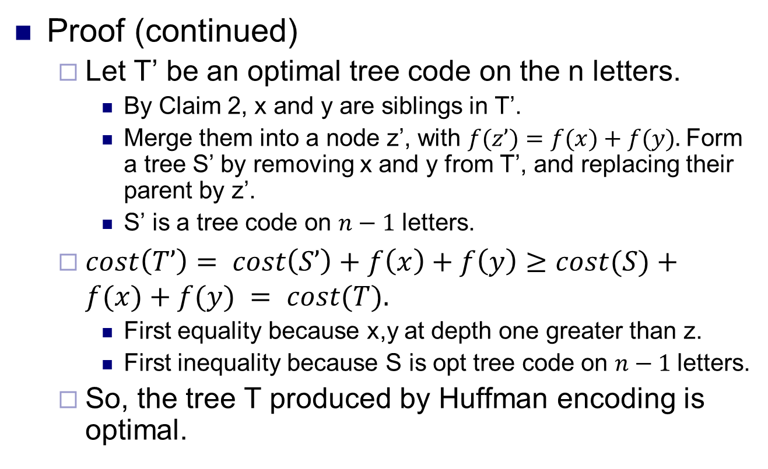
Huffman code is optimal
Proof (continued)
Let T’ be an optimal tree code on the n letters.
By Claim 2, x and y are siblings in T’.
Merge them into a node z’, with $f(z’)=f(x)+f(y).$Form a tree S’ by removing x and y from T’, and replacing their parent by z’.
S’ is a tree code on $n−1$ letters.
$cost\left(T’\right)= cost\left(S’\right)+f\left(x\right)+f\left(y\right)≥cost(S)+f(x)+f(y) = cost(T).$
First equality because x,y at depth one greater than z.
First inequality because S is opt tree code on $n−1$letters.
So, the tree T produced by Huffman encoding is optimal.

